Slide 1

CAP 6317/4773: Social Media Mining
Lecture 7: Statistical Properties of Networks
Raiyan Abdul Baten, Ph.D.
January 30, 2024

Slide 2
Recap

Slide 3
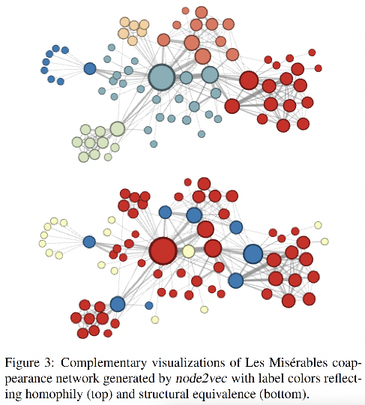
Which nodes are similar to each other?

Slide 4
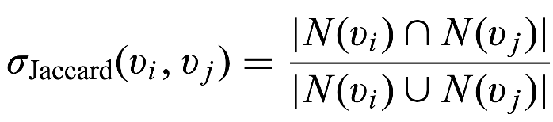

Capturing Structural Equivalence
N is the set of neighboring nodes

Slide 5
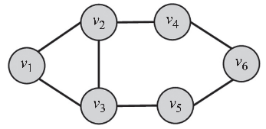
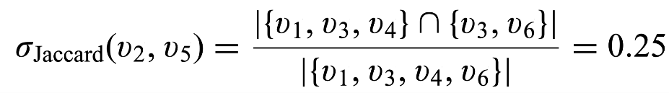
Capturing Structural Equivalence
N(v₂) = {v₁, v₃, v₄}
N(v₅) = {v₃, v₆}

Slide 6
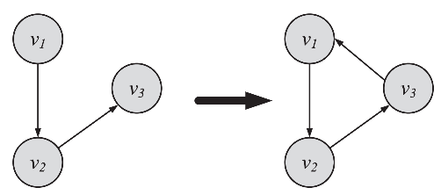
Transitive Linking
When a friend of my friend is my friend

Slide 7
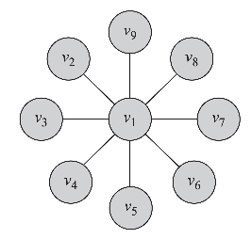
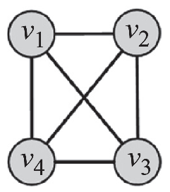
Data Mining Task: How Prevalent is Transitivity in your Data?
No triangle is closed
Clustering Coeff = 0
Example: Star Graph
All triangles are closed
Clustering Coeff = 1
Example: Fully Connected Graph

Slide 8
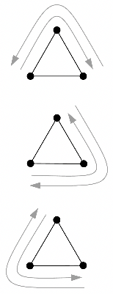


Two ways of calculating the Clustering Coefficient
1. Clustering Coefficient in terms of ‘Paths’
Each triangle has 6 closed ‘paths’

Slide 9
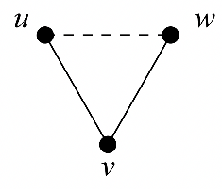

Two ways of calculating the Clustering Coefficient
2. Clustering Coefficient in terms of ‘Connected Triples’
A triangle can have 3 connected triples, one centered at each node:
uvw, vwu, and wuv.

Slide 10
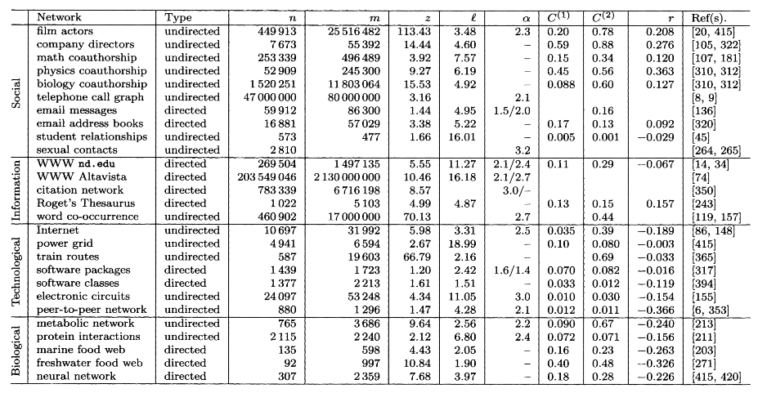
Newman, Mark EJ. "The structure and function of complex networks." SIAM Review 45.2 (2003): 167-256.

Slide 11
If the collaborations happened randomly, we would a very small C = 0.0003
Why? Imagine everyone has 500 friends on Facebook. If those friends are randomly chosen from a 2B node global network, hardly any triangles would close, and C would be really low.
A high C in real social data suggests that our connection patterns are far from random!
Newman, Mark EJ. "The structure and function of complex networks." SIAM Review 45.2 (2003): 167-256.

Slide 12

Local Clustering Coefficient
To what extent are my friends, friends with each other?
v_{i} has k_{i} = 3 friends
k_{i} nodes can have at most (k_{i} choose 2) pairwise connections among them
Here, ³C₂ = 3, so there are 3 potential pairwise connections among v_{i}’s friends
The fraction of potential pairwise connections that actually exist is the Local Clustering Coefficient
v_{i}

Slide 13
Local Clustering Coefficient
To what extent are my friends, friends with each other?
v_{i}
v_{i}
v_{i}
v_{i}
C(v_{i}) = 0
C(v_{i}) = 1/3
C(v_{i}) = 2/3
C(v_{i}) = 1

Slide 14
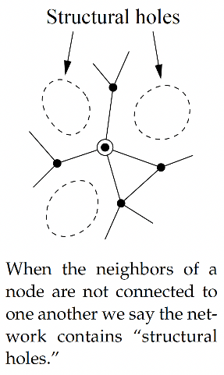
If your local clustering coefficient is low, you will have many structural holes around you, and you will have a ‘broker’ role.
Another way of capturing betweenness centrality, but at a local level

Slide 15
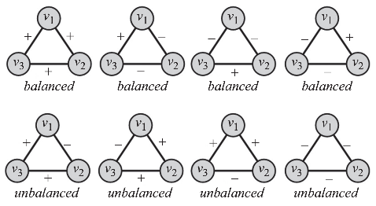
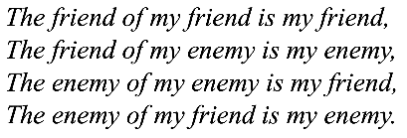
Social Balance Theory

Slide 16
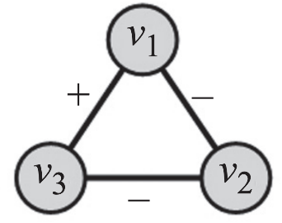

Does your data show Social Balance?
We have social balance if
w₁₃= +1
w₂₁= -1
w₃₂= -1

Slide 17
Reminder to self: Attendance

Slide 18
Note to everyone: Coding Assignment 2 published

Slide 19
Readings for Today’s Lecture: 4.1, 4.2

Slide 20
Degree Distribution

Slide 21
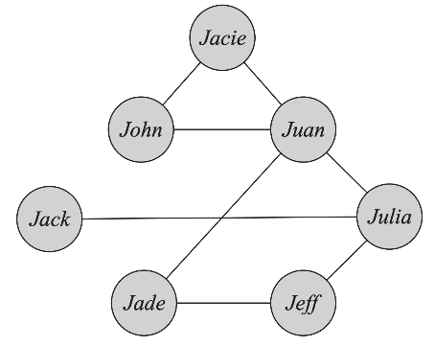
Degree Distribution

Slide 22
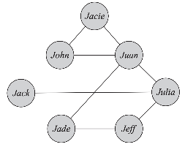
Node
Degree
Jacie
John
Juan
Jack
Julia
Jade
Jeff
2
2
4
1
3
2
2

Slide 23
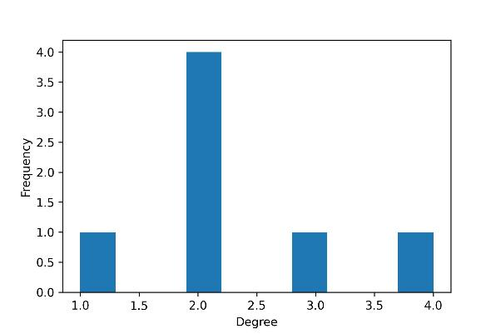
Node
Degree
Jacie
John
Juan
Jack
Julia
Jade
Jeff
2
2
4
1
3
2
2

Slide 24
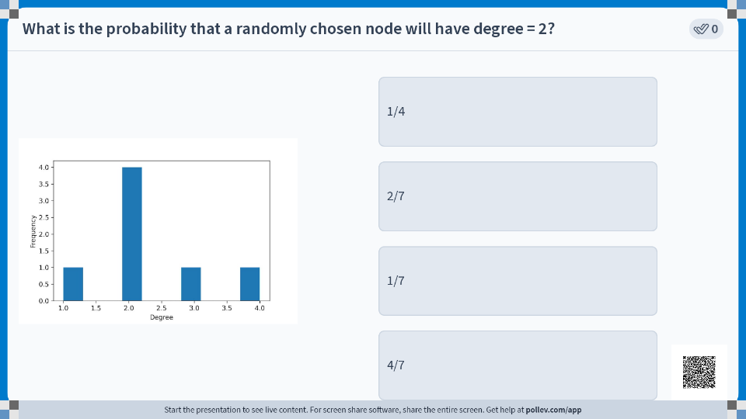

Slide 25
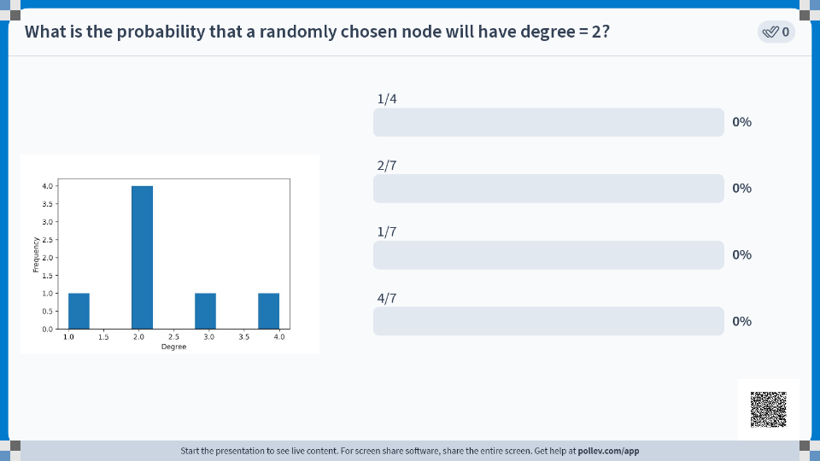

Slide 26
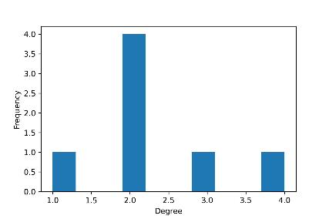
Degree Distribution
The graph has n nodes.
Out of those, n_{d} nodes have degree d.

Slide 27

Degree Distribution
The graph has n nodes.
Out of those, n_{d} nodes have degree d.
Probability that a randomly selected node v has degree d is given by,

Slide 28

Degree Distribution
The graph has n nodes.
Out of those, n_{d} nodes have degree d.
Probability that a randomly selected node v has degree d is given by,

Slide 29
Let’s look at Facebook data
Facebook on May 2011:
721 million users/nodes
Each user has 190 friends on average
A total of of 68.5 billion friendship edges

Slide 30
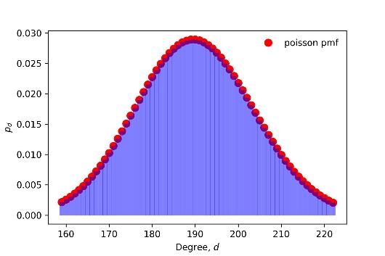
Let’s look at Facebook data
p_{d} in a random graph with the same number of nodes and edges
Facebook on May 2011:
721 million users/nodes
Each user has 190 friends on average
A total of of 68.5 billion friendship edges

Slide 31
Let’s look at Facebook data
p_{d} in a random graph with the same number of nodes and edges
Facebook on May 2011:
721 million users/nodes
Each user has 190 friends on average
A total of of 68.5 billion friendship edges
A lot of people with 190 friends

Slide 32
Let’s look at Facebook data
p_{d} in a random graph with the same number of nodes and edges
Facebook on May 2011:
721 million users/nodes
Each user has 190 friends on average
A total of of 68.5 billion friendship edges
Not too many people with too low friend counts

Slide 33
Let’s look at Facebook data
p_{d} in a random graph with the same number of nodes and edges
Facebook on May 2011:
721 million users/nodes
Each user has 190 friends on average
A total of of 68.5 billion friendship edges
Not too many people with too high friend counts

Slide 34
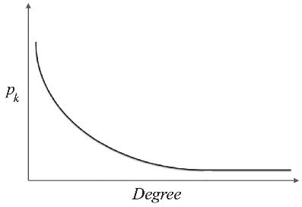
Let’s look at Facebook data
How p_{d} in the actual data looks like
Facebook on May 2011:
721 million users/nodes
Each user has 190 friends on average
A total of of 68.5 billion friendship edges

Slide 35
Let’s look at Facebook data
How p_{d} in the actual data looks like
Facebook on May 2011:
721 million users/nodes
Each user has 190 friends on average
A total of of 68.5 billion friendship edges
A LOT of people with low friend counts

Slide 36
Let’s look at Facebook data
How p_{d} in the actual data looks like
Facebook on May 2011:
721 million users/nodes
Each user has 190 friends on average
A total of of 68.5 billion friendship edges
A non-trivial number of people with extremely high number of friends

Slide 37

The Power-Law Distribution
p_{k} denotes the fraction of people with degree k.
Then, the Power-Law distribution is

Slide 38
The Power-Law Distribution
p_{k} denotes the fraction of people with degree k.
Then, the Power-Law distribution is
A negative power law exponent

Slide 39
The Power-Law Distribution
p_{k} denotes the fraction of people with degree k.
Then, the Power-Law distribution is
Power law intercept

Slide 40

The Power-Law Distribution
p_{k} denotes the fraction of people with degree k.
Then, the Power-Law distribution is
Taking the log on both sides,

Slide 41
The Power-Law Distribution
p_{k} denotes the fraction of people with degree k.
Then, the Power-Law distribution is
Taking the log on both sides,
Straight line equation!

Slide 42


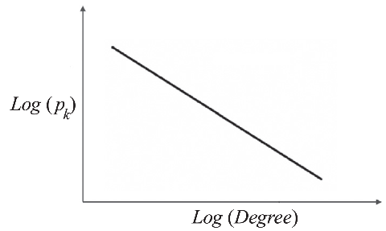
The Power-Law Distribution

Slide 43
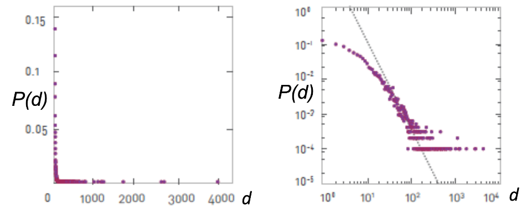

Slide 44
Let’s look at Facebook data
p_{d} in a random graph with the same number of nodes and edges
Facebook on May 2011:
721 million users/nodes
Each user has 190 friends on average
A total of of 68.5 billion friendship edges

Slide 45
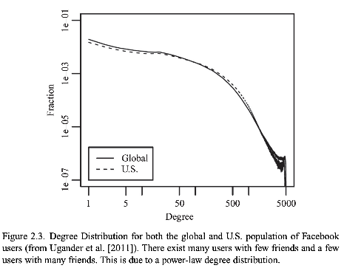
Let’s look at Facebook data
p_{d} in the actual data
Facebook on May 2011:
721 million users/nodes
Each user has 190 friends on average
A total of of 68.5 billion friendship edges
Ugander, J., Karrer, B., Backstrom, L., & Marlow, C. (2011). The anatomy of the Facebook social graph. arXiv preprint arXiv:1111.4503.

Slide 46
Let’s look at Facebook data
p_{d} in the actual data
Facebook on May 2011:
721 million users/nodes
Each user has 190 friends on average
A total of of 68.5 billion friendship edges
Both x and y axes are in log scale
Ugander, J., Karrer, B., Backstrom, L., & Marlow, C. (2011). The anatomy of the Facebook social graph. arXiv preprint arXiv:1111.4503.

Slide 47
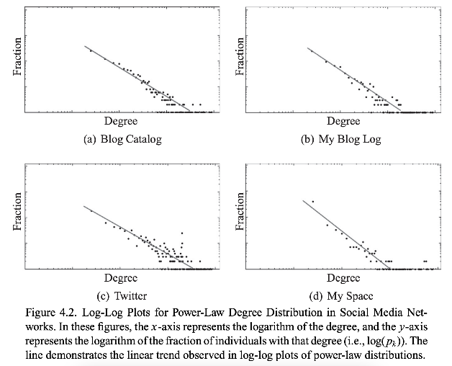

Slide 48
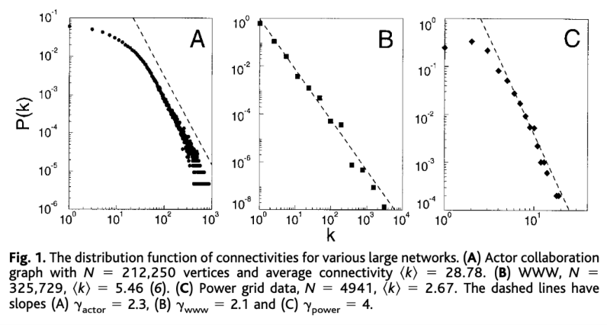
Barabási, A. L., & Albert, R. (1999). Emergence of scaling in random networks. Science, 286(5439), 509-512.

Slide 49
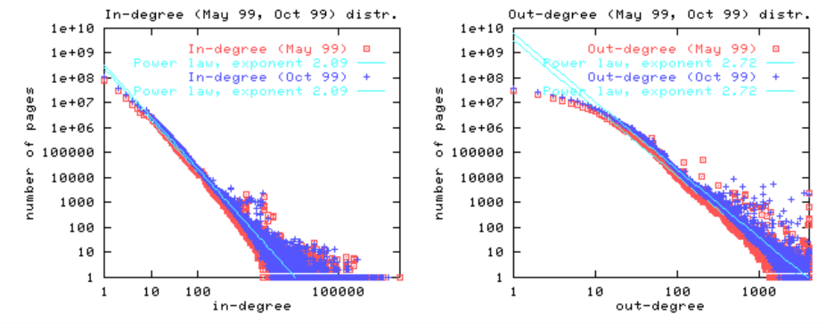
Broder, Andrei, et al. "Graph structure in the web." Computer Networks 33.1-6 (2000): 309-320.

Slide 50
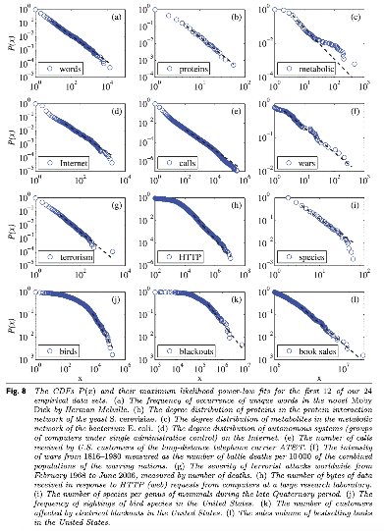

Slide 51
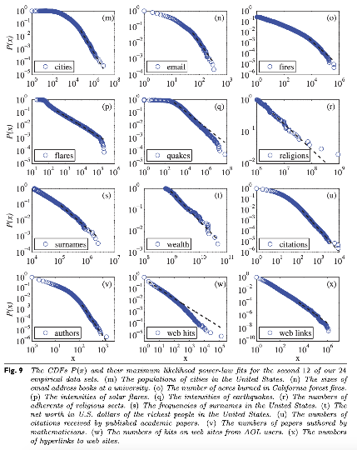

Slide 52
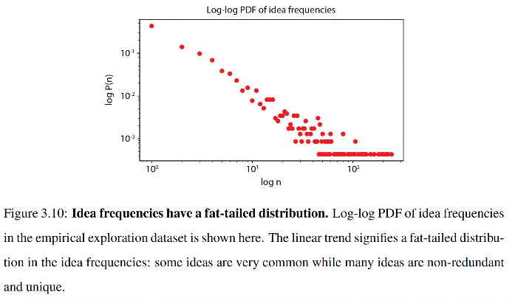

Slide 53
Random
Graphs

Slide 54
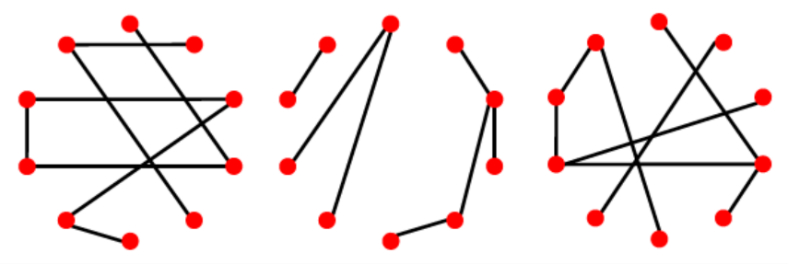

Slide 55
These graphs help establish excellent baselines. Observe how the metric you care about behaves in a suite of random graphs. Then compare if that metric in your actual data behaves differently. If yes, you have a discovery that is systematic and cannot be explained by random chance!

Slide 56
Approach 1: G(n,p)
Number of nodes, n, is fixed
A pair of nodes have an edge with probability p

Slide 57
Approach 1: G(n,p)
Pick the same n as your research data!
Number of nodes, n, is fixed
A pair of nodes have an edge with probability p

Slide 58
Approach 1: G(n,p)
The exact number of edges can be different, since p is simply doing a coin toss. Over many random graphs with the same n and p, you’d get a fixed expected number of edges that is determined by p.
Number of nodes, n, is fixed
A pair of nodes have an edge with probability p

Slide 59
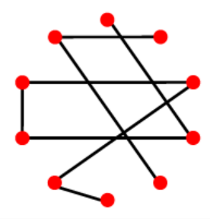
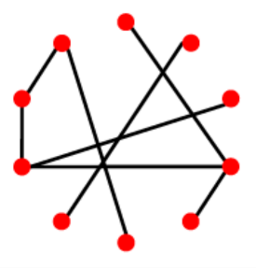
Approach 2: G(n,m) Erdos-Renyi Random Graph
Number of nodes, n, is fixed
Number of edges, m, is also fixed
Randomly assign which node-pairs will have those edges

Slide 60
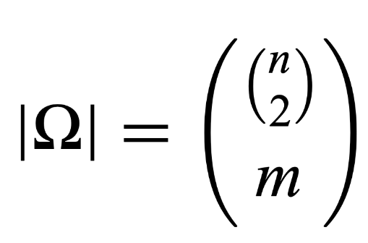
Set of all possible random graphs G(n,m)

Slide 61
(n choose 2) possible edges

Slide 62
Choose m edges out of those

Slide 63
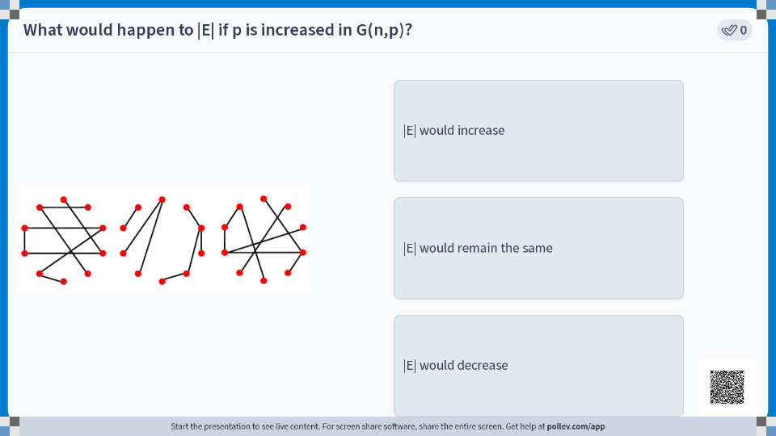

Slide 64
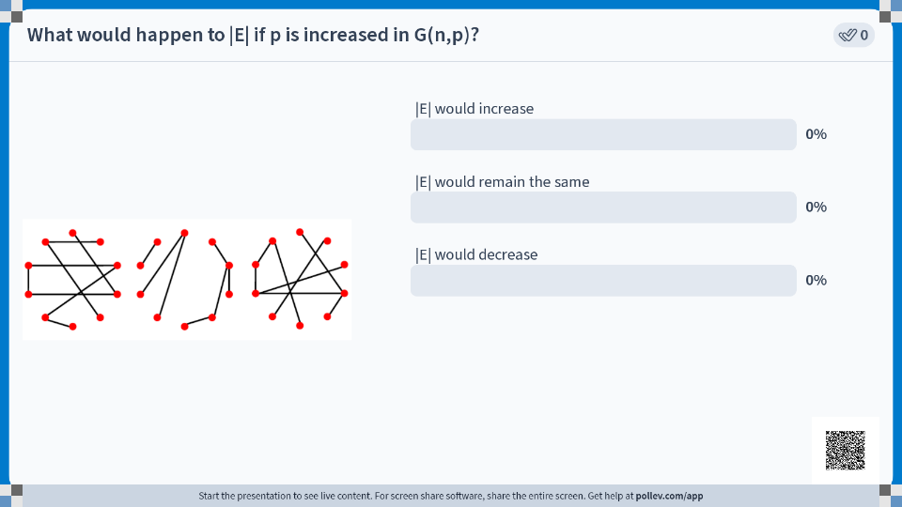

Slide 65
Summary

